Slide 1

Gathering DATA MODELLING REQUIREMENTS FOR THE LAKEHOUSE
How you can collaboratively design a star schema with your business users
Johnny Winter

Slide 2


ABOUT ME

Slide 3



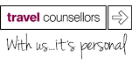



Slide 4
Why are we here?

Slide 5


Slide 6


Slide 7
Is star schema still relevant?

Slide 8
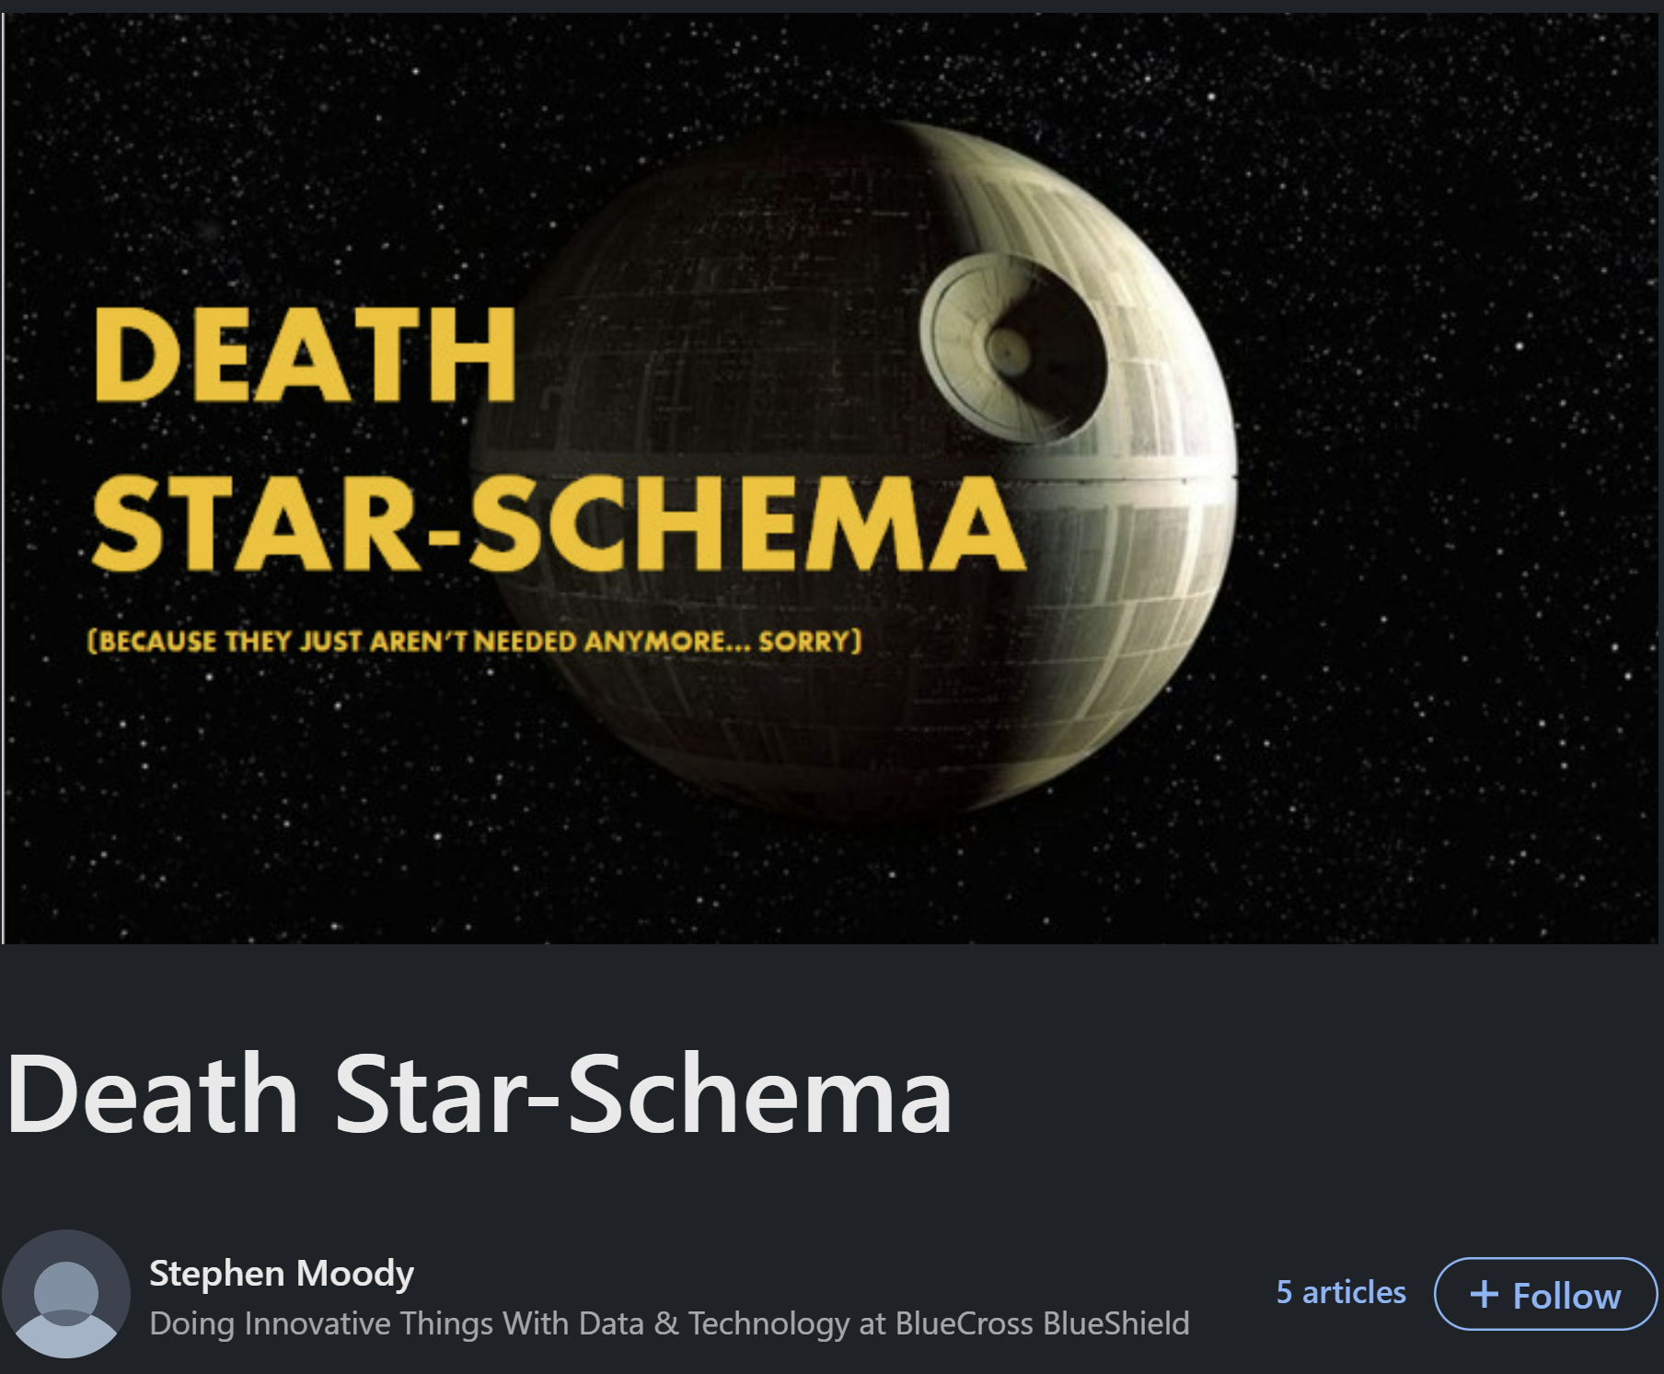
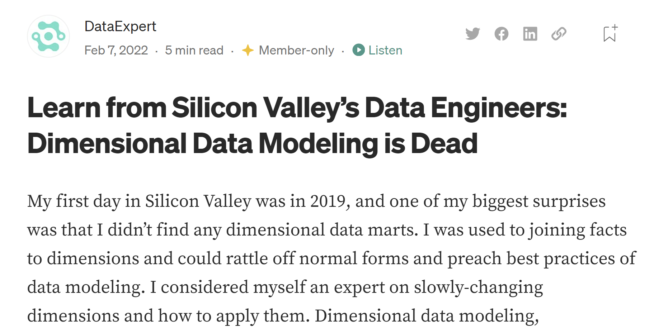
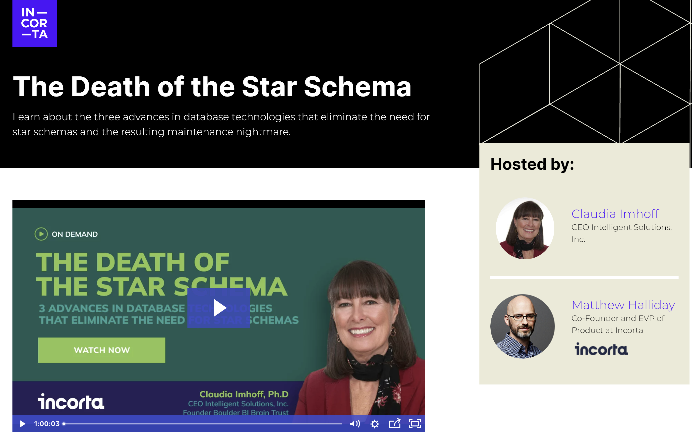
Is star schema still relevant?

Slide 9

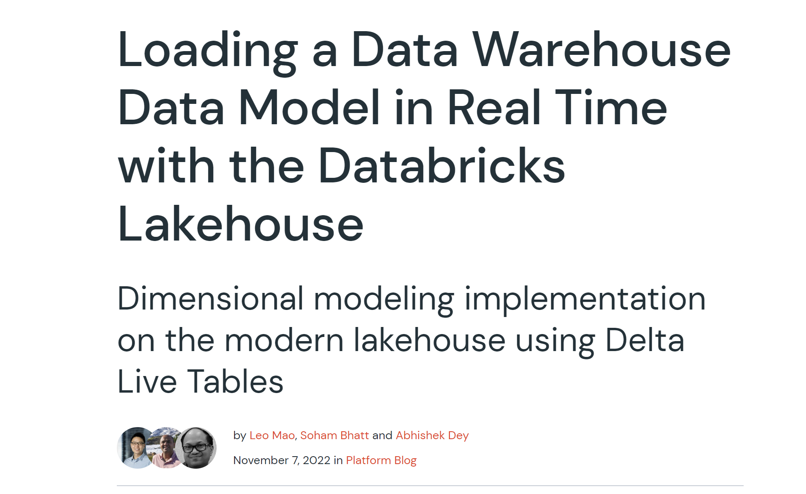
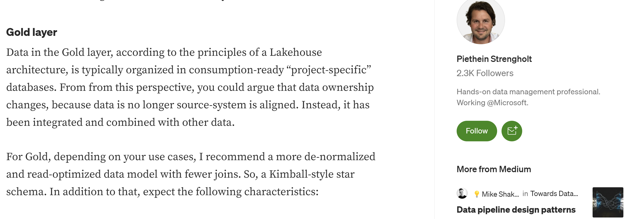

Slide 10
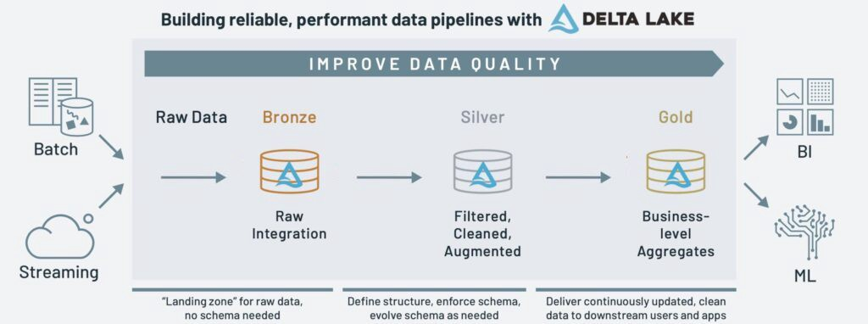
Medallion architecture

Slide 11
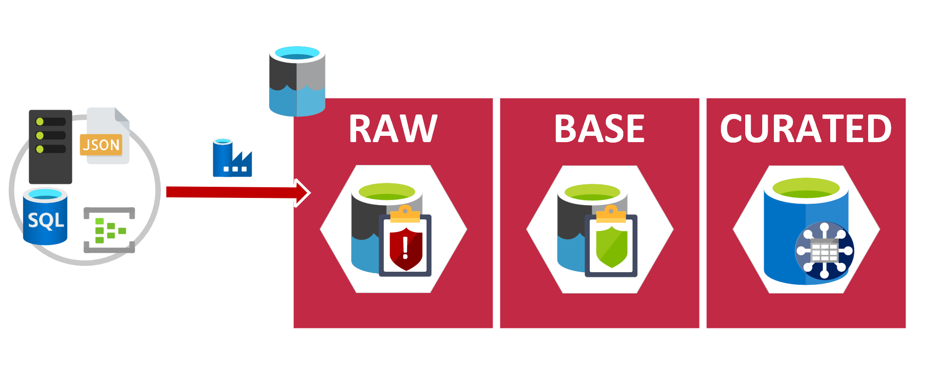
Advancing analytics architecture

Slide 12
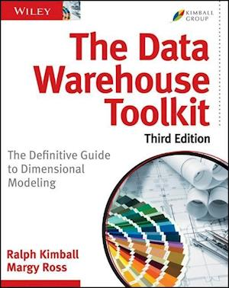
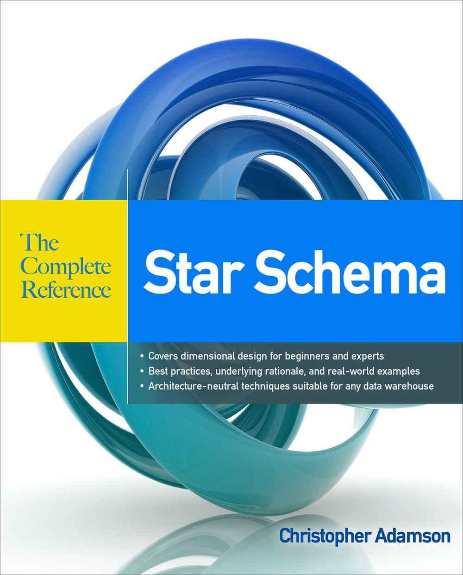
What is a star schema?

Slide 13





Different personas
Developers
Very technical
Can write code
Understand the tech
Business users
Understand the business
Know what they want to see
Not always great at explaining what they need

Slide 14
Requirements gathering methodology

Slide 15

sunbeam

Slide 16
DATA MODELLING TOOLS & TECHNIQUES
BEAM*
SUN MODELLING

Slide 17
Beam*

Slide 18
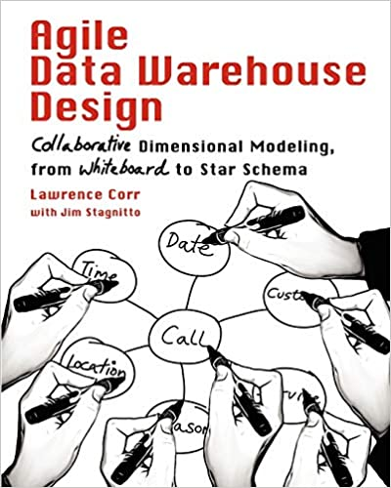
BEAM*
Agile Data Warehouse Design by Lawrence Corr
Business Event Analysis & Modelling
3 Ds
7 Ws

Slide 19
SUN MODELLING

Slide 20

Sun modelling
Word of mouth technique
Advocates of Sun Modelling
Emma Zambonini
Pete Moore
Terry McCann
Mark Whitehorn
Professor of Analytics at the University of Dundee

Slide 21
TYPES OF DATA MODEL
User model
Physical model
Logical model

Slide 22
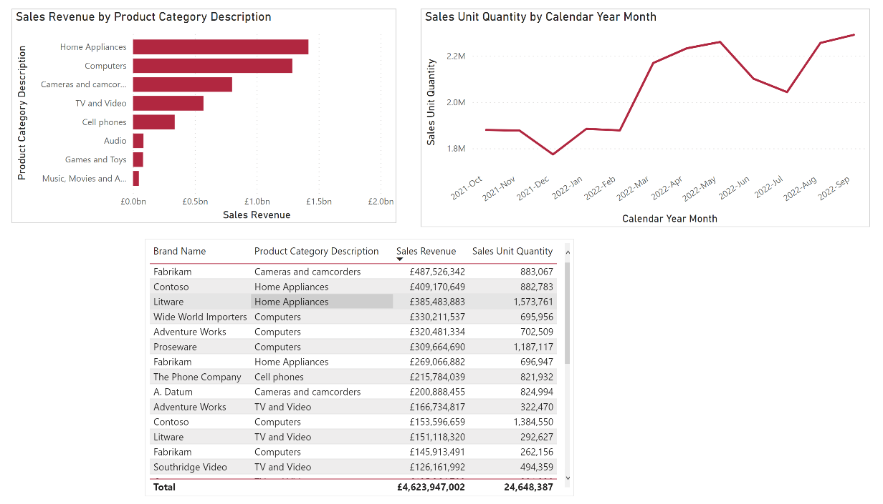
User model

Slide 23
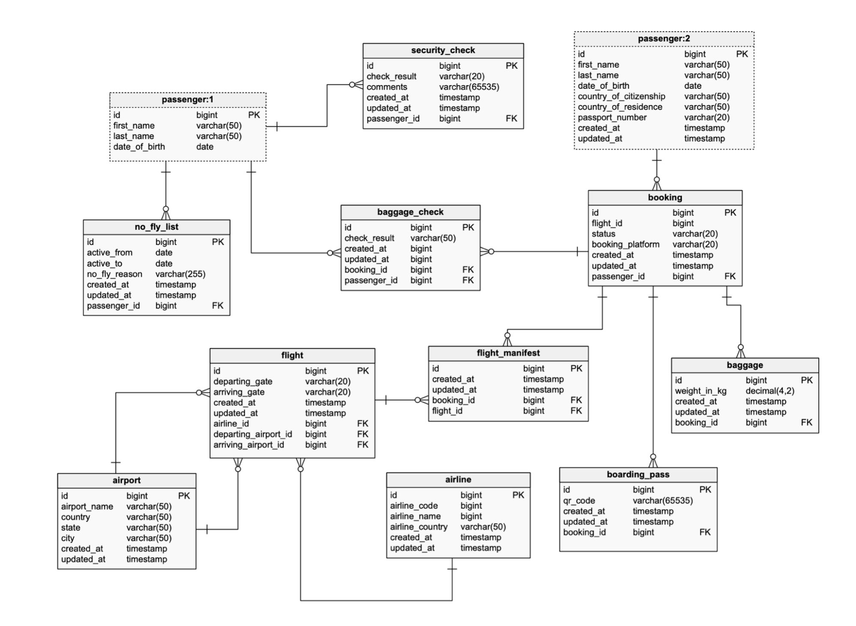
Physical model

Slide 24
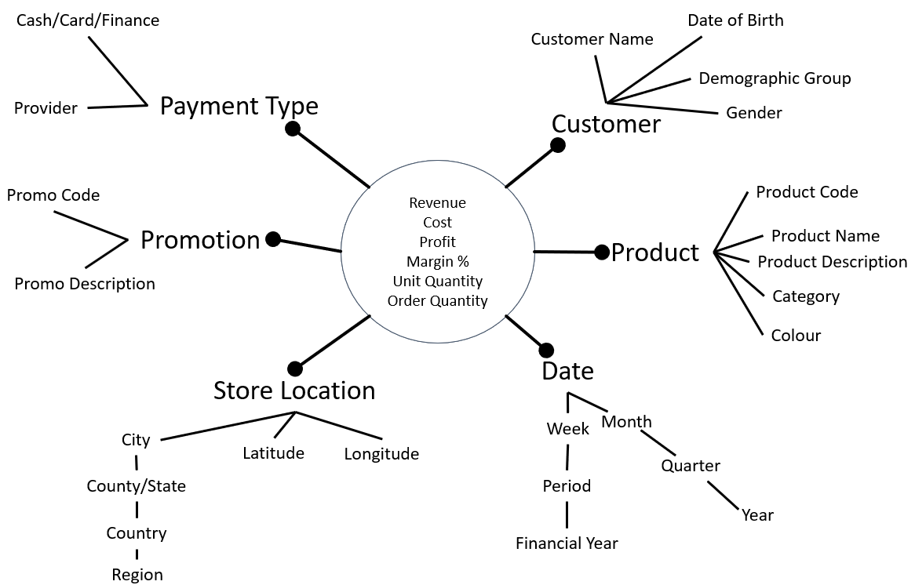
Logical model

Slide 25
Running a workshop

Slide 26




Hold A workshop
Miro
Mural
MS Whiteboard

Slide 27
WHO TO INVITE?
Get your business users involved
Good to have 2 people running the workshop. One facilitator, one scribe.
Choose one business process
Invite 3-5 people with domain knowledge

Slide 28
The 3 ds

Slide 29
The 3 Ds
Discover an event
“who does what?”
Describe an event
USE THE 7 Ws
Document an event
SUN MODELLING

Slide 30
discover

Slide 31
WHO DOES WHAT?

Slide 32
DESCRIbe

Slide 33
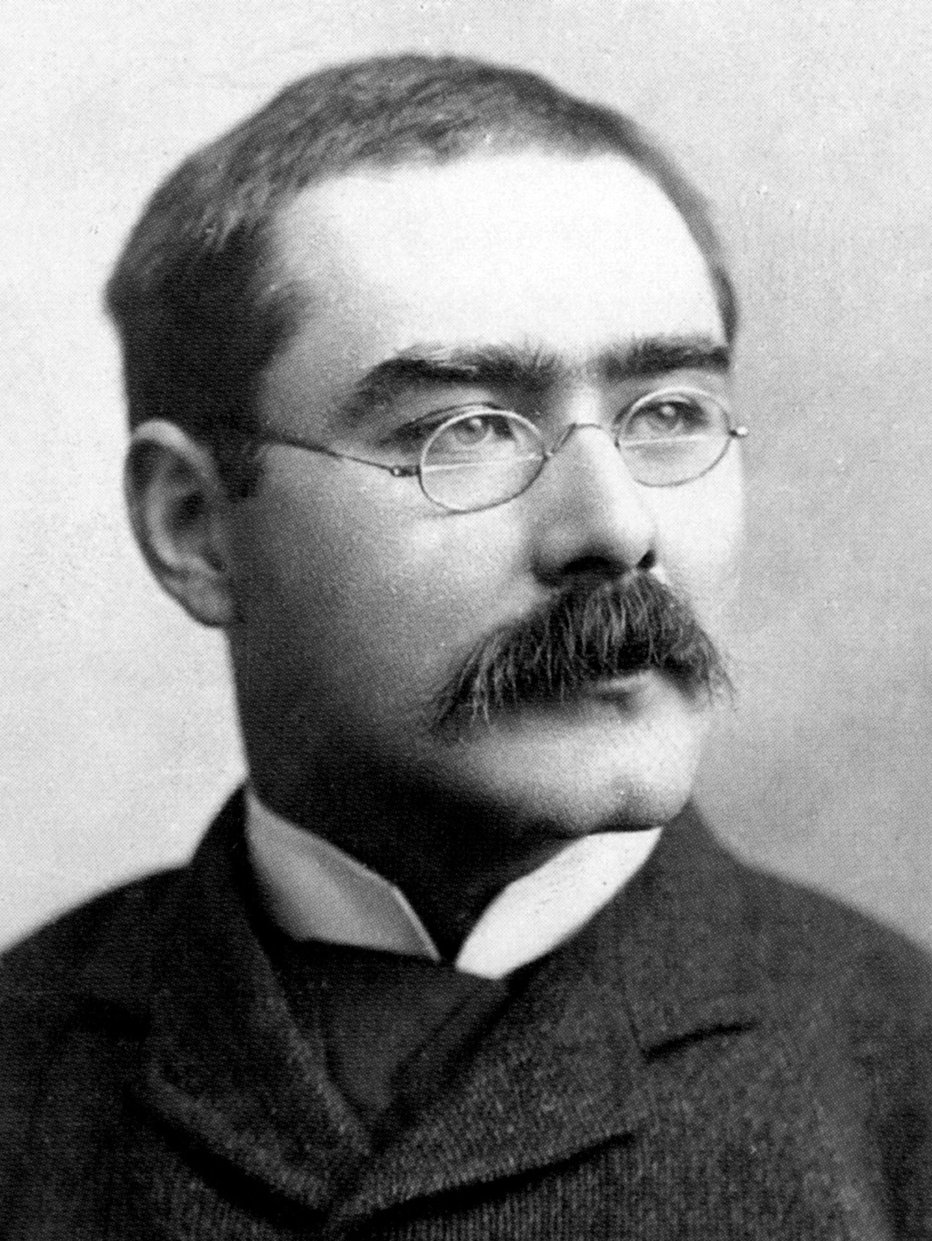
“I keep six honest serving men (they taught me all I knew); Their names are What and Why and When and How and Where and Who”
- Rudyard Kipling

Slide 34
7W s
Who?
What?
When?
Where?
Why?
How?
How many?

Slide 35
DOCUMENT

Slide 36
WHO DOES WHAT?
Customer buys product
Cash/Card/Finance
Date of Birth
Customer Name
HOW MANY
Demographic Group
Provider
Payment Type
Customer
Gender
WHO
Revenue
Cost
Profit
Margin %
Unit Quantity
Order Quantity
WHAT
Promo Code
Product Code
Promotion
Product Name
WHEN
Product
Product Description
Promo Description
Category
WHERE
Colour
WHY
Date
Store Location
HOW
Month
City
Week
Latitude
Longitude
Quarter
County/State
Period
Year
Country
Financial Year
Region

Slide 37
Tips and advice
Ask the 7Ws multiple times – often there is more than one answer
…but for some Ws there may be no answers
One sun model per event
Hold multiple workshops if necessary
You can do this before data discovery if you like
Don’t get bogged down in what you already know about your data
You may wish to use your logical model to go away and design a physical model
But this isn’t the finished/fixed design – it’s a target, but may change during implementation
You can consolidate multiple sun models in to a Bus Matrix

Slide 38
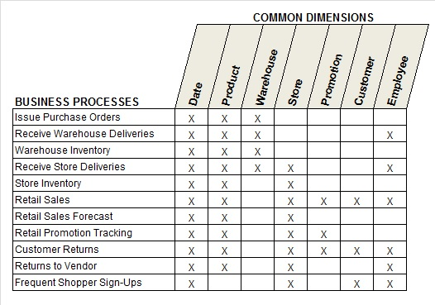

Slide 39
GaPS
Assumes one-to-many relationships.
Design doesn’t cover things like bridge tables
Doesn’t cover dimension types.
This tends to come out during implementation

Slide 40

MAKE IT YOUR OWN!

Slide 41
Questions?

Slide 42
Thank you!

